Slide 1
Double Prototypical Model For Few-shot Slot Tagging in Natural Language Understanding
汇报人：袁尤良
日期：2020/10/11
Hey Siri, 添加 Mojito 到 我的 播放列表

Slide 2
Introduction
Related Work
Problem Formulation
Model
Experiments
Conclusion

Slide 3
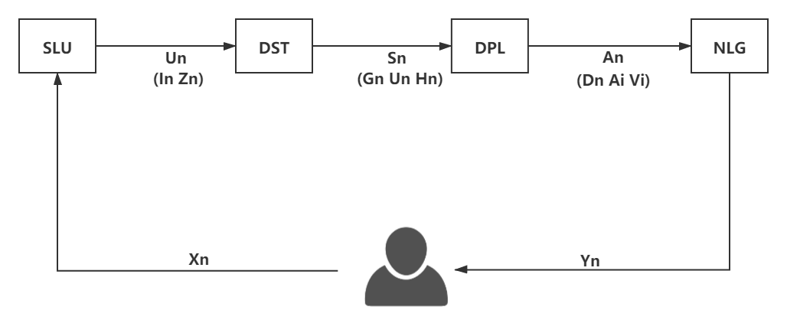
INTRODUCTION
Spoken Language Understanding
Dialog State Tracking
Dialog Policy Learning
Natural Language Generation
play the playlist tropical morning on pandora
O O O B-playlist I-playlist O B-service
O:Others
B:Begin
I :In
Slot:
Intent: PlayMusic
Notes:
Slot tagging(Tur and De Mori,2011) is a core task in natural language understanding(NLU) Which a key conponent of task-oriented dialogue system(Young et al.,2013).Now, Slot tagging is usually formulatd as a sequence labeling problem(Mesnil et al., 2015;Sarikaya et al.,2016;Liu and Lane, 2016)

Slide 4
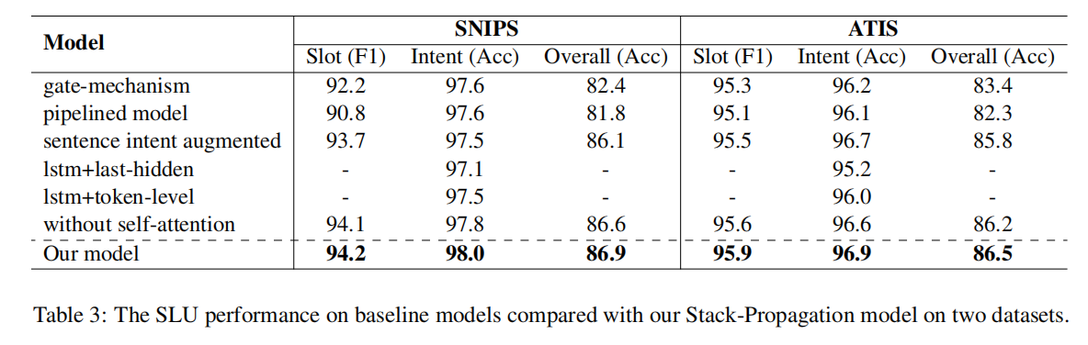
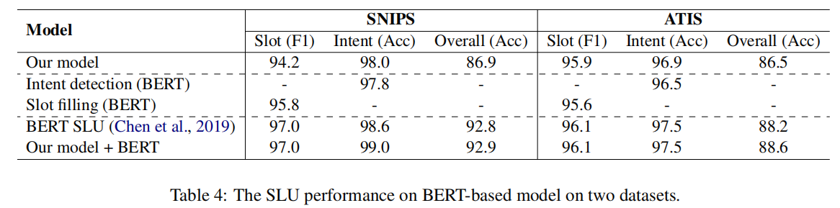
INTRODUCTION
很猛很猛的神经网络
arXiv:1909.02188v1
Notes:
Although Deep Learning models have show their power in NLU, these models still require abundant labeled training data.
But for new domains, there are only a few samples. Thus, fewshot learning(Fei-Fei et al., 2006; Lake et al., 2015; Vinyals et al., 2016) has received more and more attention in rencent years (Fritzler et a;., 2019; Geng et al., 2019; Hou et al., 2020). These approaches extract transferable knowledge among old domains and transferred to new domains quickly with few examples

Slide 5
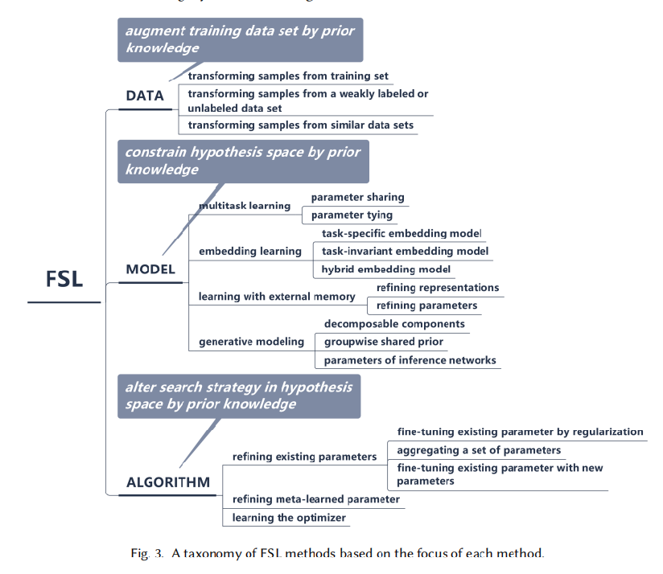
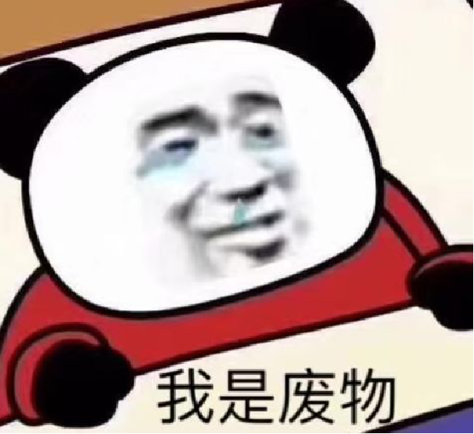
INTRODUCTION
我:Hey Siri , 为了避免跟特朗普一样中招,什么时间、场合应该戴好口罩?
Siri:我在网上没有找到”为了避免...好口罩”的有关资料
arXiv:1904.05046 [cs]
Notes:
Although Deep Learning models have show their power in NLU, these models still require abundant labeled training data.
But for new domains, there are only a few samples. Thus, fewshot learning(Fei-Fei et al., 2006; Lake et al., 2015; Vinyals et al., 2016) has received more and more attention in rencent years (Fritzler et a;., 2019; Geng et al., 2019; Hou et al., 2020). These approaches extract transferable knowledge among old domains and transferred to new domains quickly with few examples

Slide 6
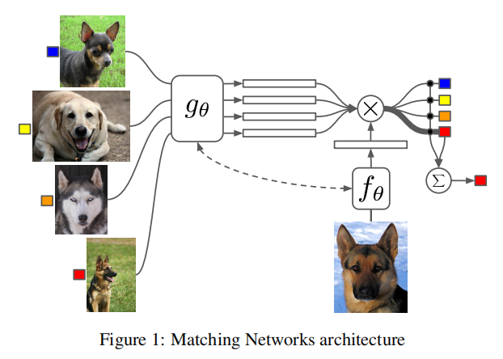
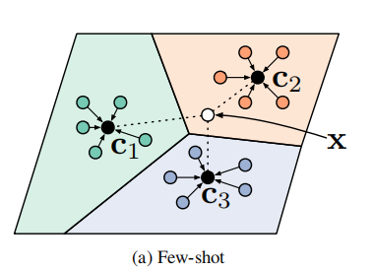
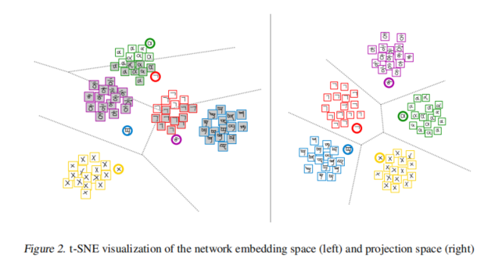
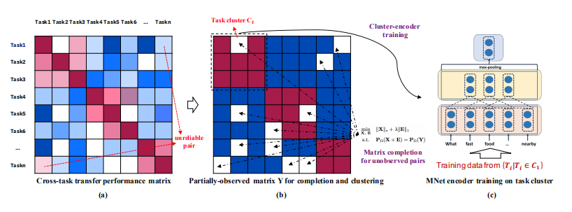
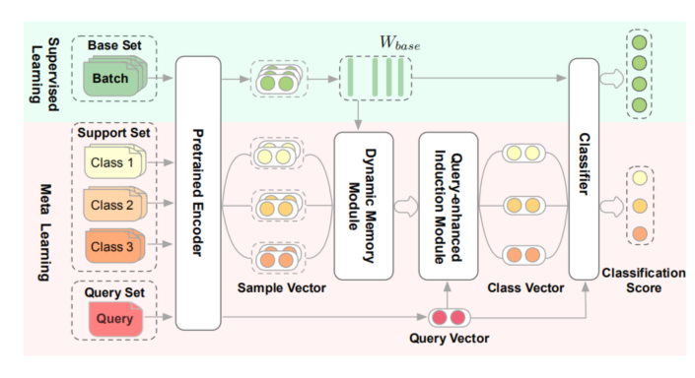
INTRODUCTION
Snell et al., 2017
Vinyals et al., 2016
Sung et al., 2019
CV
TapNet
General Extractor
few examples
Text Classification
NLP
Yu et al., 2018
Geng et al., 2019
Notes:
Although Deep Learning models have show their power in NLU, these models still require abundant labeled training data.
But for new domains, there are only a few samples. Thus, fewshot learning(Fei-Fei et al., 2006; Lake et al., 2015; Vinyals et al., 2016) has received more and more attention in rencent years ( Yu et al.,2018;Fritzler et a;., 2019;Geng et al., 2019; Hou et al., 2020; Su et al.,2020). These approaches extract transferable knowledge among old domains and transferred to new domains quickly with few examples

Slide 7
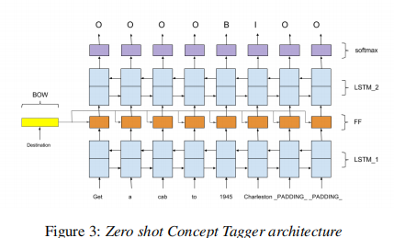
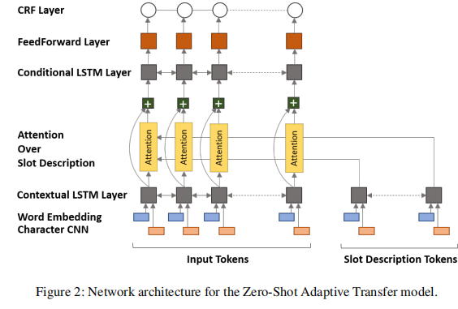
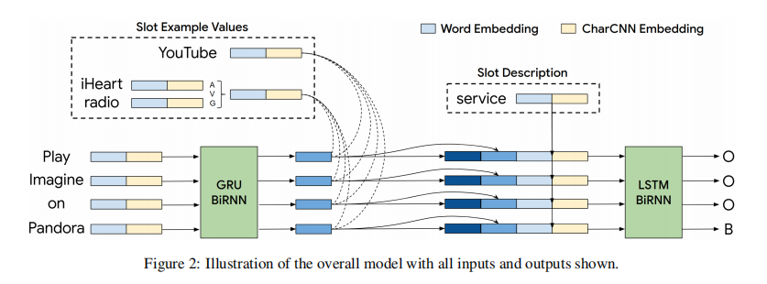
INTRODUCTION
Similarity-based Methods For FSL-SF Task
Bapna et al., 2017
Sung et al., 2019
Zero-Shot
Shah et al., 2019
Notes:
The similarity-based few-shot learning motheds classify an item in a new domain according to its similarity with the representation of each class, and has been widely used in classification problems(Vinyals et al., 2016; Snell et al., 2017; Sung et al., 2018; Yan et al., 2018; Yu et al., 2018; Sun et al., 2019; Geng et al., 2019; Yoon et al., 2019)
A general encoder is learned in rich-resource domains to extract feature for items in resource domain and per class representation is obtained from few labeled samples(support set) by utilizing the encoder.
By considering both the item similarity and label dependency, model Label-enhanced TapNet with CDT achieved state-of-the-art performance. Performance of the model has been further improved by using vector projection similarity(Su et al. 2020)
There is a problem in all previous similarity-based approaches(in slot tagging task), they pay too more attention to the word and ignore the importance of environment of the word. For example, “ add ghost on the dance floor to my autumn lounge playlist”, they will compute the similarity between “ghost on the dance floor” and class representation of class B/I-entity_name. This is rediculous, because we classify the entity name by its environment(“add” and “to”) rather than the words themselves.他们看问题太不全面了,或者说期望于把中性词与环境融为一体而达到同时考虑的效果,但是这样会彼此干扰.

Slide 8
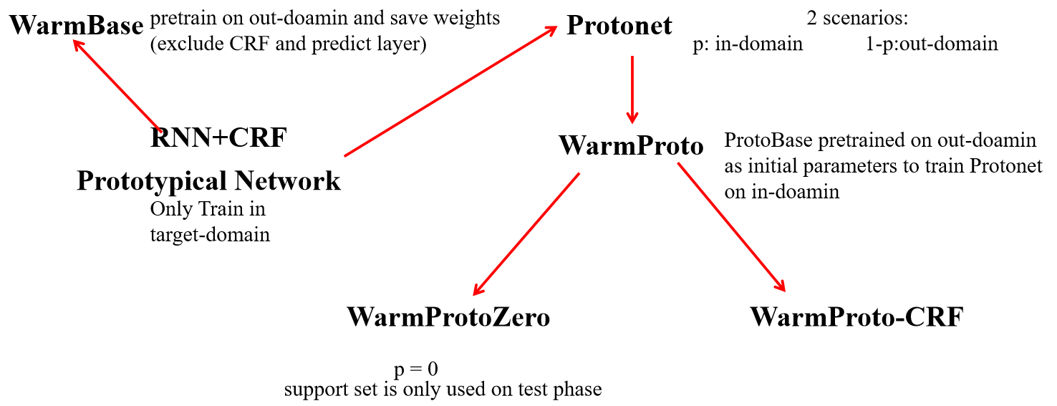
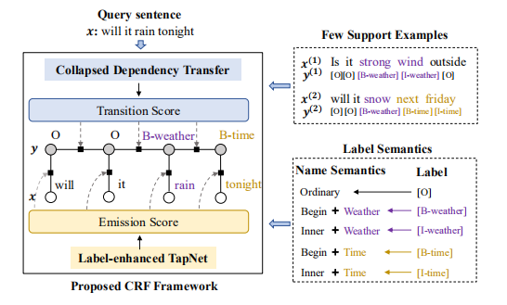
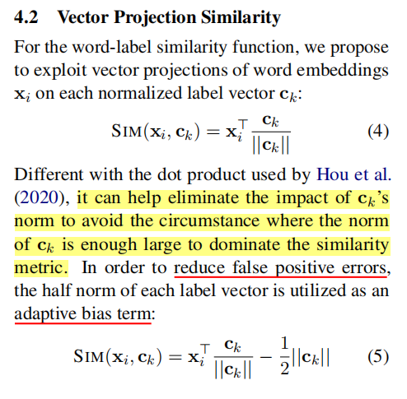
INTRODUCTION
Similarity-based Methods For FSL-SF Task
Fritzler et al., 2019
Hou et al., 2020
Su et al., 2020
Notes:
The similarity-based few-shot learning motheds classify an item in a new domain according to its similarity with the representation of each class, and has been widely used in classification problems(Vinyals et al., 2016; Snell et al., 2017; Sung et al., 2018; Yan et al., 2018; Yu et al., 2018; Sun et al., 2019; Geng et al., 2019; Yoon et al., 2019)
A general encoder is learned in rich-resource domains to extract feature for items in resource domain and per class representation is obtained from few labeled samples(support set) by utilizing the encoder.
By considering both the item similarity and label dependency, model Label-enhanced TapNet with CDT achieved state-of-the-art performance. Performance of the model has been further improved by using vector projection similarity(Su et al. 2020)
There is a problem in all previous similarity-based approaches(in slot tagging task), they pay too more attention to the word and ignore the importance of environment of the word. For example, “ add ghost on the dance floor to my autumn lounge playlist”, they will compute the similarity between “ghost on the dance floor” and class representation of class B/I-entity_name. This is rediculous, because we classify the entity name by its environment(“add” and “to”) rather than the words themselves.他们看问题太不全面了,或者说期望于把中性词与环境融为一体而达到同时考虑的效果,但是这样会彼此干扰.

Slide 9
INTRODUCTION
Consider both the word similarity and environment similarity
Our contributions are summarized as follows:
We provide a unique perspective to on similarity between pytotype and word, and propose a Double Prototypical Mechanism(DPM)
We explore to improve existing advanced model for few-shot tagging by combining it with DPM and the experiments on slot tagging validate the effectiveness
Notes:
In this paper, we propose Double Prototypical Mechanism(DPM)(是否用机制更加合适?) to tackle above challenge.DPM aim to make full use of environmental information and word information. Different from previous work, we take advantage of environmental information and word information seperatly rather than mix them up.
(The double Prototypical scenario poses challenges in constructing a good environmental prototype and coupling two similarity scores well.)
One-shot and five shot experiments on slot tagging and Name entity recognization(NER)(Hou et al., 2020) tasks show that our method can siginificantly enhance existing advanced methods like TapNet(Yoon et al., 2019; Hou et al., 2020; Su et al., 2020) by utilizing local and global environmental information and achieve state-of-the-art performances.
Our contributions are summarized as follows:
1.We provide a unique perspective to on similarity between pytotype and word and propose a Double Prototypical Mechanism(DPM)
2.We explore to improve existing advanced model for few-shot tagging by combining with DPM and the experiments on slot tagging and Name entity recoginization validate the effectiveness

Slide 10
Introduction
Related Work
Problem Formulation
Model
Experiments
Conclusion

Slide 11
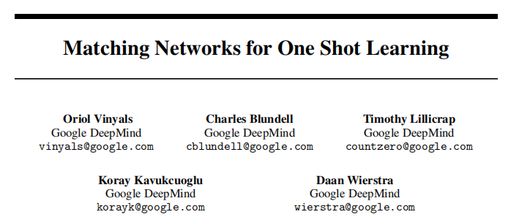

Related Work
Learn a general encoder and compute similarity between support sample and query sample
Vinyals et al., 2016
Notes:
Classical methodologies for few-shot learning in image classification field primarily focus on metric learning( Snell et al.,2017;Vinyals et al.,2016), which aim to learn a general distance metric and use it in the new domain.
In natural language processing community, classification tasks such as text classification(Sun et al., 2019; Geng et al.,2019, Yu et al.,2018, Yan et al., 2018) draw more attention. In recent years, reseachers are paying more and more attention to few-shot learning for slot tagging task. Zero shot slot tagging approaches (Bapna et al., 2017; Lee and Jha, 2019; Shah et al.2019) achieved state-of-the-art by utilizing label name semantics(and label description ,examples). Fritzler et al.(2019) explored few-shot NER with prototypical network. Hou et al.(2020) exploited the Label-enhanced TapNet and Collapsed Dependency Transfer for both slot tagging and NER tasks. Su et al.(2020) achieved better performance in new domain by utilizing vector projection as word-label similarities. Compared to these motheds, We construct two prototype (environmental prototype and word prototype) to fully use information in word and sentence,. In some case, environmental information and word information are each other's noise , DPM can eliminate this noise and achieve better performance

Slide 12
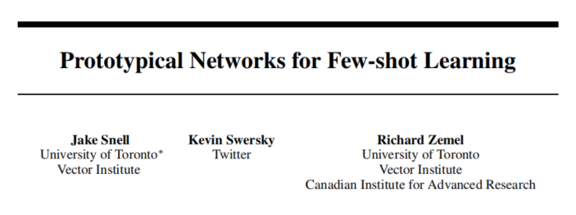
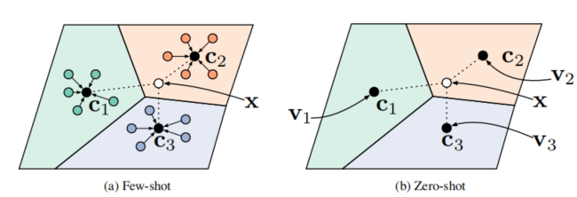


Related Work
Snell et al., 2017
Notes:
Classical methodologies for few-shot learning in image classification field primarily focus on metric learning( Snell et al.,2017;Vinyals et al.,2016), which aim to learn a general distance metric and use it in the new domain.
In natural language processing community, classification tasks such as text classification(Sun et al., 2019; Geng et al.,2019, Yu et al.,2018, Yan et al., 2018) draw more attention. In recent years, reseachers are paying more and more attention to few-shot learning for slot tagging task. Zero shot slot tagging approaches (Bapna et al., 2017; Lee and Jha, 2019; Shah et al.2019) achieved state-of-the-art by utilizing label name semantics(and label description ,examples). Fritzler et al.(2019) explored few-shot NER with prototypical network. Hou et al.(2020) exploited the Label-enhanced TapNet and Collapsed Dependency Transfer for both slot tagging and NER tasks. Su et al.(2020) achieved better performance in new domain by utilizing vector projection as word-label similarities. Compared to these motheds, We construct two prototype (environmental prototype and word prototype) to fully use information in word and sentence,. In some case, environmental information and word information are each other's noise , DPM can eliminate this noise and achieve better performance

Slide 13
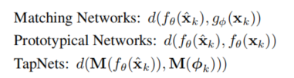
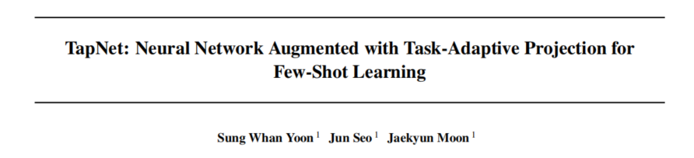
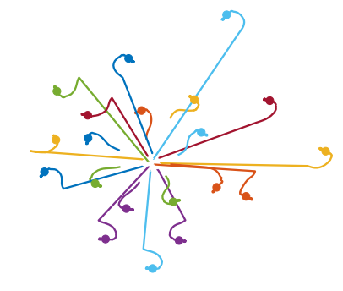
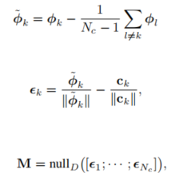
Related Work
embedding function
projection(task- dependent adaptive)
per-class reference vectors
Sung et al., 2019
Notes:
Classical methodologies for few-shot learning in image classification field primarily focus on metric learning( Snell et al.,2017;Vinyals et al.,2016), which aim to learn a general distance metric and use it in the new domain.
In natural language processing community, classification tasks such as text classification(Sun et al., 2019; Geng et al.,2019, Yu et al.,2018, Yan et al., 2018) draw more attention. In recent years, reseachers are paying more and more attention to few-shot learning for slot tagging task. Zero shot slot tagging approaches (Bapna et al., 2017; Lee and Jha, 2019; Shah et al.2019) achieved state-of-the-art by utilizing label name semantics(and label description ,examples). Fritzler et al.(2019) explored few-shot NER with prototypical network. Hou et al.(2020) exploited the Label-enhanced TapNet and Collapsed Dependency Transfer for both slot tagging and NER tasks. Su et al.(2020) achieved better performance in new domain by utilizing vector projection as word-label similarities. Compared to these motheds, We construct two prototype (environmental prototype and word prototype) to fully use information in word and sentence,. In some case, environmental information and word information are each other's noise , DPM can eliminate this noise and achieve better performance

Slide 14
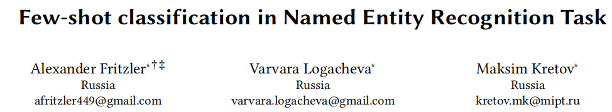
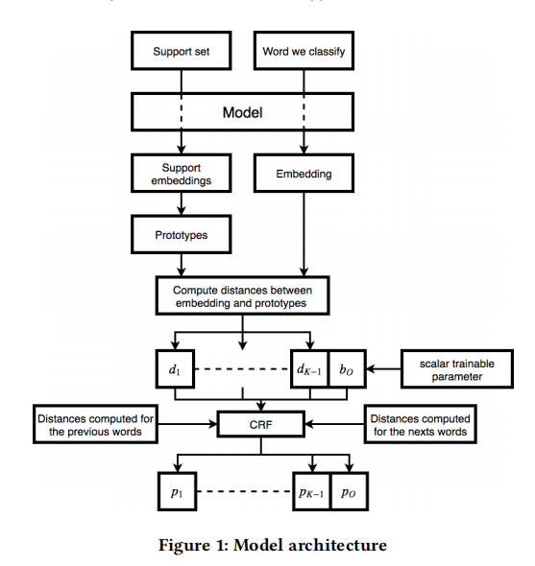
Related Work
Fritzler et al., 2019
Notes:
Classical methodologies for few-shot learning in image classification field primarily focus on metric learning( Snell et al.,2017;Vinyals et al.,2016), which aim to learn a general distance metric and use it in the new domain.
In natural language processing community, classification tasks such as text classification(Sun et al., 2019; Geng et al.,2019, Yu et al.,2018, Yan et al., 2018) draw more attention. In recent years, reseachers are paying more and more attention to few-shot learning for slot tagging task. Zero shot slot tagging approaches (Bapna et al., 2017; Lee and Jha, 2019; Shah et al.2019) achieved state-of-the-art by utilizing label name semantics(and label description ,examples). Fritzler et al.(2019) explored few-shot NER with prototypical network. Hou et al.(2020) exploited the Label-enhanced TapNet and Collapsed Dependency Transfer for both slot tagging and NER tasks. Su et al.(2020) achieved better performance in new domain by utilizing vector projection as word-label similarities. Compared to these motheds, We construct two prototype (environmental prototype and word prototype) to fully use information in word and sentence,. In some case, environmental information and word information are each other's noise , DPM can eliminate this noise and achieve better performance

Slide 15
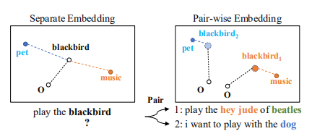
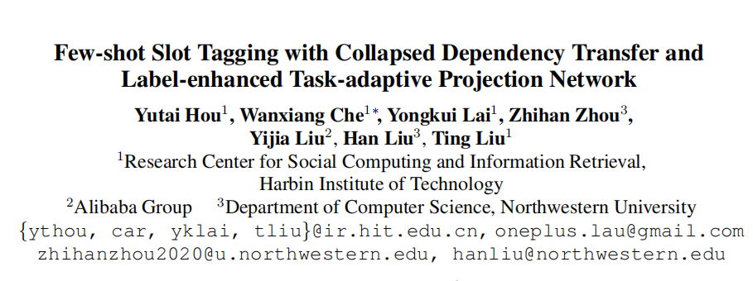
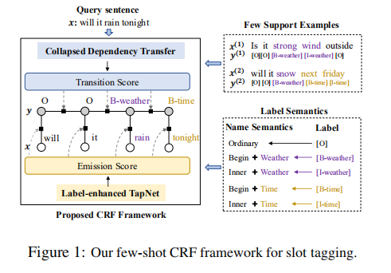
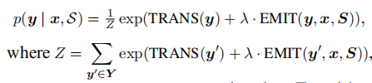
Related Work
Hou et al., 2020
Notes:
Classical methodologies for few-shot learning in image classification field primarily focus on metric learning( Snell et al.,2017;Vinyals et al.,2016), which aim to learn a general distance metric and use it in the new domain.
In natural language processing community, classification tasks such as text classification(Sun et al., 2019; Geng et al.,2019, Yu et al.,2018, Yan et al., 2018) draw more attention. In recent years, reseachers are paying more and more attention to few-shot learning for slot tagging task. Zero shot slot tagging approaches (Bapna et al., 2017; Lee and Jha, 2019; Shah et al.2019) achieved state-of-the-art by utilizing label name semantics(and label description ,examples). Fritzler et al.(2019) explored few-shot NER with prototypical network. Hou et al.(2020) exploited the Label-enhanced TapNet and Collapsed Dependency Transfer for both slot tagging and NER tasks. Su et al.(2020) achieved better performance in new domain by utilizing vector projection as word-label similarities. Compared to these motheds, We construct two prototype (environmental prototype and word prototype) to fully use information in word and sentence,. In some case, environmental information and word information are each other's noise , DPM can eliminate this noise and achieve better performance

Slide 16
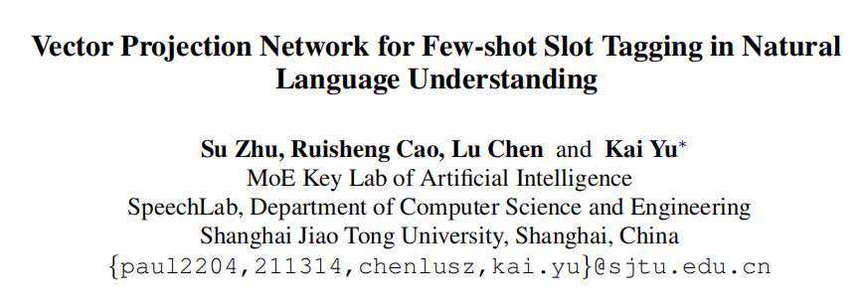


Related Work
DOT
VECTOR PROJECTION
这哥们看数据看得够仔细
Su et al., 2020
Notes:
Classical methodologies for few-shot learning in image classification field primarily focus on metric learning( Snell et al.,2017;Vinyals et al.,2016), which aim to learn a general distance metric and use it in the new domain.
In natural language processing community, classification tasks such as text classification(Sun et al., 2019; Geng et al.,2019, Yu et al.,2018, Yan et al., 2018) draw more attention. In recent years, reseachers are paying more and more attention to few-shot learning for slot tagging task. Zero shot slot tagging approaches (Bapna et al., 2017; Lee and Jha, 2019; Shah et al.2019) achieved state-of-the-art by utilizing label name semantics(and label description ,examples). Fritzler et al.(2019) explored few-shot NER with prototypical network. Hou et al.(2020) exploited the Label-enhanced TapNet and Collapsed Dependency Transfer for both slot tagging and NER tasks. Su et al.(2020) achieved better performance in new domain by utilizing vector projection as word-label similarities. Compared to these motheds, We construct two prototype (environmental prototype and word prototype) to fully use information in word and sentence,. In some case, environmental information and word information are each other's noise , DPM can eliminate this noise and achieve better performance

Slide 17
Introduction
Related Work
Problem Formulation
Model
Experiments
Conclusion

Slide 18







Problem Formulation
sentence:
Source domains:
label sequence:
Target domains:
A domain:
Support set:
domain-specific label set:
Query set like Support set without y
each domain contain N different labels
N way K shot
Notes:
前提都是fewshot slot tagging task ,非fewshot senario有待explore
为何要用上下文信息,因为被浪费了,比如add , the , is 最后都变成了O, 这些O词的本身的信息是可以被显式利用的, 但是却在还没有被利用就被他collepsed了
然后一个词的信息 = 词本身含义(上下文消歧) + 词所处的环境, 可是否则几乎没有被利用, 最多算是在bert里面有信息流到中心词去了, 但是在有的情况下词义主导, 有的情况是环境主导, 光靠bert是不行的

Slide 19
Introduction
Related Work
Problem Formulation
Model
Experiments
Conclusion

Slide 20
Model(DPM)
In Few-shot case
Hey Siri, 添加 Mojito 到 我的 播放列表
Noise
Only rely on Bert ?
DPM
没法对混合体进行很好的建模 无法比较好的消除噪声
L-enhance or not
更自由
对word 和 environment可实现完全不同的操作
Notes:
In this section, we first introduce our approache DPM, then we discuss how to combine our mechanism with existed advance few-shot model.
1.DPM considers total information of a word include information of itself and environmental information of the word. And sometimes devide them into two parts will be better as them mutual pollute. For example, ”add this is not a song to my playlist my favorite”, we know “this is not a song” is name of the song because its environmental rather than it is samilar to other song names. If you mix two kinds of information as contextual word embeddings, it's too difficult for similarity-based neural network to distinguish whether it is a song or not . DPM tackle this challenge by constructing two environmental extractor(global&local) to generate local and global environmetal embeddings for each word.
1.1 local environmental extractor
given an utterance x = (x1,x2,x3,....,xn) with n words, where xi (维度) is the embedding of the t-th word. We get the embedding from Bert in same way to Hou et al.(2020). Then expand x to x' = (pad1, pad2, ...padw, x1, x2 ..., xn, pad1, pad2,..padw) where padi is zero tensor and w is local window size. For each word, we can obtain its local environmental embedding xile = f(xi-w, xi-w+1,..xi-1, xi+1,.xi+w), f(.) is fully connecting layer.
1.2 global environmental extractor
For x = (x1,x2,...,xn), we first add position signal to x and obtain x'=(x1',x2',...,xn'), then x' is feeded to environmental attention layer, it is similar to self attention layer but we get output yi without take vi into consideration because we just want the information of environment.After Layer normalization, we feed the output to feed Forward layer like figure 3. Finally we will get global environmental embedding.

Slide 21
Model(DPM)
What is environment?
Notes:
In this section, we first introduce our approache DPM, then we discuss how to combine our mechanism with existed advance few-shot model.
1.DPM considers total information of a word include information of itself and environmental information of the word. And sometimes devide them into two parts will be better as them mutual pollute. For example, ”add this is not a song to my playlist my favorite”, we know “this is not a song” is name of the song because its environmental rather than it is samilar to other song names. If you mix two kinds of information as contextual word embeddings, it's too difficult for similarity-based neural network to distinguish whether it is a song or not . DPM tackle this challenge by constructing two environmental extractor(global&local) to generate local and global environmetal embeddings for each word.
1.1 local environmental extractor
given an utterance x = (x1,x2,x3,....,xn) with n words, where xi (维度) is the embedding of the t-th word. We get the embedding from Bert in same way to Hou et al.(2020). Then expand x to x' = (pad1, pad2, ...padw, x1, x2 ..., xn, pad1, pad2,..padw) where padi is zero tensor and w is local window size. For each word, we can obtain its local environmental embedding xile = f(xi-w, xi-w+1,..xi-1, xi+1,.xi+w), f(.) is fully connecting layer.
1.2 global environmental extractor
For x = (x1,x2,...,xn), we first add position signal to x and obtain x'=(x1',x2',...,xn'), then x' is feeded to environmental attention layer, it is similar to self attention layer but we get output yi without take vi into consideration because we just want the information of environment.After Layer normalization, we feed the output to feed Forward layer like figure 3. Finally we will get global environmental embedding.

Slide 22
Model (Local Environmental Extractor)
Linear Layer
Window Size(Pad)
Exclude the word
Notes:
In this section, we first introduce our approache DPM, then we discuss how to combine our mechanism with existed advance few-shot model.
1.DPM considers total information of a word include information of itself and environmental information of the word. And sometimes devide them into two parts will be better as them mutual pollute. For example, ”add this is not a song to my playlist my favorite”, we know “this is not a song” is name of the song because its environmental rather than it is samilar to other song names. If you mix two kinds of information as contextual word embeddings, it's too difficult for similarity-based neural network to distinguish whether it is a song or not . DPM tackle this challenge by constructing two environmental extractor(global&local) to generate local and global environmetal embeddings for each word.
1.1 local environmental extractor
given an utterance x = (x1,x2,x3,....,xn) with n words, where xi (维度) is the embedding of the t-th word. We get the embedding from Bert in same way to Hou et al.(2020). Then expand x to x' = (pad1, pad2, ...padw, x1, x2 ..., xn, pad1, pad2,..padw) where padi is zero tensor and w is local window size. For each word, we can obtain its local environmental embedding xile = f(xi-w, xi-w+1,..xi-1, xi+1,.xi+w), f(.) is fully connecting layer.
1.2 global environmental extractor
For x = (x1,x2,...,xn), we first add position signal to x and obtain x'=(x1',x2',...,xn'), then x' is feeded to environmental attention layer, it is similar to self attention layer but we get output yi without take vi into consideration because we just want the information of environment.After Layer normalization, we feed the output to feed Forward layer like figure 3. Finally we will get global environmental embedding.

Slide 23
Model(Global Environmental Extractor)
Environmental Attention Layer
No Window
Exclude the word
Notes:
In this section, we first introduce our approache DPM, then we discuss how to combine our mechanism with existed advance few-shot model.
1.DPM considers total information of a word include information of itself and environmental information of the word. And sometimes devide them into two parts will be better as them mutual pollute. For example, ”add this is not a song to my playlist my favorite”, we know “this is not a song” is name of the song because its environmental rather than it is samilar to other song names. If you mix two kinds of information as contextual word embeddings, it's too difficult for similarity-based neural network to distinguish whether it is a song or not . DPM tackle this challenge by constructing two environmental extractor(global&local) to generate local and global environmetal embeddings for each word.
1.1 local environmental extractor
given an utterance x = (x1,x2,x3,....,xn) with n words, where xi (维度) is the embedding of the t-th word. We get the embedding from Bert in same way to Hou et al.(2020). Then expand x to x' = (pad1, pad2, ...padw, x1, x2 ..., xn, pad1, pad2,..padw) where padi is zero tensor and w is local window size. For each word, we can obtain its local environmental embedding xile = f(xi-w, xi-w+1,..xi-1, xi+1,.xi+w), f(.) is fully connecting layer.
1.2 global environmental extractor
For x = (x1,x2,...,xn), we first add position signal to x and obtain x'=(x1',x2',...,xn'), then x' is feeded to environmental attention layer, it is similar to self attention layer but we get output yi without take vi into consideration because we just want the information of environment.After Layer normalization, we feed the output to feed Forward layer like figure 3. Finally we will get global environmental embedding.

Slide 24
Model
Environment Based and Word Based
Local and Global
Similarity Incorpoation
Notes:
2. Incoporate to L-enhanced TapNet
不同similarity的耦合,
environment-enhanced有待探索
2.1Overrall Architecture
An Overview of DPMLT is shown in fingure2, which is build on Label-enhanced Task-adaptive Projection Network(Hou et al., 2020). The main framework is CRF, Emission Score is designed by DPM and CDT is attached to transition Scorer.
In Emission scorer, Word embedding is used in two ways: First, we feed it to Label-enhanced TapNet just like Hou,In another way, we obtain global environmental embedding and local environmental embedding from oringinal embedding by utilizing the extractors.Then we feed these two embeddings to TapNet rather than L-enhanced TapNet respectively. Finally, we get the emission score.
2.2Environmental prototype based
as figure3,as mentioned in before, We have constructed two environmental extractors , thus, we can get xle = (xle1, xle2...,xlen) and xge = (xge1, xge2,...xgen), feed they to TapNets respectively. Label-enhanced TapNet is useless here , because environment is not related to the label directly and use L-enhance bring worse performance. Global Environmental similarity score and Local Environmental similarity score are computed by using vector projection similarity function(Su et al., 2020) which could allivate the influence cased by norm difference among two kinds of prototype(global and local).(a,b), VP is also used in L-enhanced TapNet (记得介绍一下VP和VPB)
Finally , we sum up two eimission(a,b)

Slide 25
Introduction
Related Work
Problem Formulation
Model
Experiments
Conclusion

Slide 26
Experiment(setting)
7 different domians in SNIPS dataset:
Weather(We), Music(Mu), PlayList (Pl), Book (Bo), Search Screen(Se), Restaurant (Re) and Creative Work (Cr)
10 seeds 10150-10159
F1 Score
Notes:
IN our experiment, we evaluate the DPMLT folloing the dataset provided by Hou on Snips(Coucke et al., 2018) and NER datasets.Each episode(Vinyals et al.,2016) contain support set and query set .
For NER,we use 4 different datasets simulate they are from 4 different domains: CoNLL-2003 (News) (Sang and De Meulder, 2003), GUM (Wiki) (Zeldes, 2017), WNUT-2017 (Social) (Derczynski et al., 2017) and OntoNotes (Mixed) (Pradhan et al., 2013).
There are 7 different domians in SNIPS dataset for slot tagging: Weather(We), Music(Mu), PlayList (Pl), Book (Bo), Search Screen(Se), Restaurant (Re) and Creative Work (Cr). More details are shown in Appendix.
Follow Hou, For each dateset, we utilize 5 domains to teain , one domain for validation and one domain for evaluation. And We report the average F1 scores at the episode level as well. For each experiment, we run it ten times with different random seeds to allivate the nondeterministic of neural network training(Reimers and Gurevych, 2017). More training details are illustrated in Appendix

Slide 27
Experiment
Baseline:
SimBERT:Fix BERT and find similar word
TransferBERT: Trainable linear classifier and fine tune in support
LWCPV
LTCPV
Ours: LTCPV+DPM
Notes:
Baseline
SimBert
TransferBERT
L-WPZ+CDT + PWE(LWCP)
L-TapNet+CDT + PWE(LTCP)
L-WPZ+CDT+PWE + VP(LWCPV)
L-TapNet+CDT+PWE +VP(LTCPV)
borrow the results of these baseline from Hou and Su
缩写描述

Slide 28
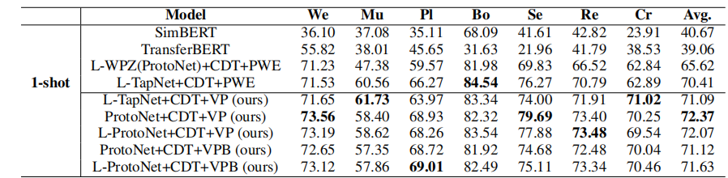
Experiment
Attention+vp | 77.49 | 60.41 | 69.58 | 85.29 | 77.32 | 74.96 | 70.06 | 73.59
Linear+vp | 75.47 | 61.86 | 71.55 | 84.44 | 77.87 | 75.84 | 63.23 | 72.89
Attn+Linear+vp | 77.61 | 62.48 | 72.50 | 85.57 | 78.30 | 76.31 | 66.97 | 74.25
Attention+vpb | 79.28 | 61.53 | 69.50 | 86.40 | 77.76 | 76.79 | 72.09 | 74.76
Linear+vpb | 76.64 | 61.30 | 75.00 | 86.16 | 79.90 | 75.69 | 65.49 | 74.31
Attn+Linear+vpb | 78.42 | 63.05 | 72.88 | 87.40 | 79.11 | 76.77 | 70.41 | 75.43
seed:10150-10155
seed:10150-10155
seed:15150-10159
seed:10150
Notes:
Main Results:
Rsult of 1-shot Setting:
table1 shows the result of 1-shot slo tagging.ach column respectively shows the F1 scores of taking a certain domain as target domain and the rest domains as source domain(train & dev).Our method can siginificantly outperform from all baselines include the previous sota model. As shown in the table, The model with DPM achieves the best performance and it outperform the direct baseline(L-TapNet+CDT+VP) and the best baseline by average F1 scores of 4.34 and 3.06 respectively
By comparing “L-TapNet+CDT+PWE+VP”with “LTCVP+DPM”,We can find that our proposed DPM can siginificantly improve the similarity-base model L-TapNet-CDT-VP . This demonstrating the effectiveness of Double Prototype mechanism. By utilizing local and global environmental informations, DPM capture important environmental information by two extractors and further develope previous similarity-based model. When turn the vector projection to VPB, the model performance better slightly, that is to say DPM is coupling with VPB well

Slide 29
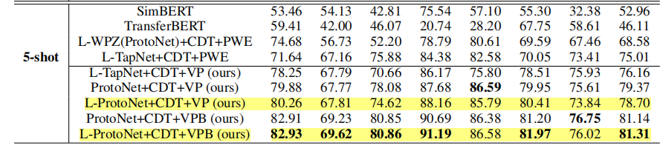
Experiment
10150 | Attention+vp | 81.75 | 69.30 | 78.51 | 90.35 | 86.66 | 80.69 | 72.09 | 79.91
 | Linear+vp | 86.04 | 72.78 | 83.02 | 89.38 | 87.91 | 80.86 | 69.06 | 81.29
 | Attn+Linear+vp | 82.94 | 74.60 | 79.12 | 89.22 | 88.67 | 81.62 | 68.11 | 80.61
10150 10150 -10155 | Attention+vpb | 84.55 | 71.13 | 77.37 | 90.33 | 86.68 | 81.02 | 71.74 | 80.40
 | Linear+vpb | 85.75 | 72.18 | 85.10 | 88.86 | 88.38 | 81.78 | 68.00 | 81.44
 | Attn+Linear+vpb | 85.32 | 74.63 | 83.15 | 90.23 | 88.55 | 81.51 | 73.21 | 82.37
Notes:
5-shot setting
results of the table consistent with table1. Confirm effectiveness of DPM again
Analysis
Ablation Study, 1.local global use 1-shot as example 二者都有用 2. window size

Slide 30
Introduction
Related Work
Problem Formulation
Model
Experiments
Conclusion

Slide 31
Conclusion
novelty perspective for what is similarity
powerful mechanism DPM for similarity-based model
borrow vector projection from Su
Experiment results validate Both Local and global environment improve the tagging accuracy
Further work about DPM will be explored, we expect DPM can play a role in not only NLP but also CV.
Find more suitable environmental extractors is also a promising work.
Notes:
要有展望
In this paper, we provide a novelty perspective for what is similarity. And we propose a powerful mechanism DPM for similarity-based model in few-shot slot tagging which consider both word similarity and environment similarity. To couple different similarities with different norm, we borrow vector projection from Su.Experiment results validae Both Local and global environment improve the tagging accuracy.
Further work about DPM will be explored, we expect DPM can play a role in not only NLP but also CV. And find more suitable environmental extractors is also a promising work

Slide 33
The academic is not an army race. It does not really matter how fancy the model is. It does not really matter whether the model can achieve the stoa performance. The real innovation is to find something new and this work has found a fresh new perspective.----某ICML Editor
f

